Slide 1
Unit 9

Slide 2
RISC and CISC in Computer Organization
RISC is the way to make hardware simpler whereas CISC is the single instruction that handles multiple work.
Reduced Instruction Set Architecture (RISC)
It stands for Reduced Instruction Set Computer.
It is a type of microprocessor architecture that uses a small set of instructions of uniform length.
These are simple instructions that are generally executed in one clock cycle.
RISC chips are relatively simple to design and inexpensive.
The setback of this design is that the computer has to repeatedly perform simple operations to execute a larger program having a large number of processing operations. Examples: SPARC, POWER PC, etc.

Slide 3
Characteristics of RISC
Simpler instruction, hence simple instruction decoding.
Instruction comes undersize of one word.
Instruction takes a single clock cycle to get executed.
More general-purpose registers.
Simple Addressing Modes.
Fewer Data types.
A pipeline can be achieved.

Slide 4
Advantages of RISC
Simpler instructions: RISC processors use a smaller set of simple instructions, which makes them easier to decode and execute quickly. This results in faster processing times.
Faster execution: Because RISC processors have a simpler instruction set, they can execute instructions faster than CISC processors.
Lower power consumption: RISC processors consume less power than CISC processors, making them ideal for portable devices.

Slide 5
Disadvantages of RISC
More instructions required: RISC processors require more instructions to perform complex tasks than CISC processors.
Increased memory usage: RISC processors require more memory to store the additional instructions needed to perform complex tasks.
Higher cost: Developing and manufacturing RISC processors can be more expensive than CISC processors.

Slide 6
Complex Instruction Set Architecture (CISC)
It stands for Complex Instruction Set Computer.
These processors offer the users, hundreds of instructions of variable sizes.
CISC architecture includes a complete set of special-purpose circuits that carry out these instructions at a very high speed.
These instructions interact with memory by using complex addressing modes.
CISC processors reduce the program size and hence lesser number of memory cycles are required to execute the programs.
This increases the overall speed of execution.
Examples: Intel architecture, AMD

Slide 7
Characteristics of CISC
Complex instruction, hence complex instruction decoding.
Instructions are larger than one-word size.
Instruction may take more than a single clock cycle to get executed.
Less number of general-purpose registers as operations get performed in memory itself.
Complex Addressing Modes.
More Data types.

Slide 8
Advantages of CISC
Reduced code size: CISC processors use complex instructions that can perform multiple operations, reducing the amount of code needed to perform a task.
More memory efficient: Because CISC instructions are more complex, they require fewer instructions to perform complex tasks, which can result in more memory-efficient code.
Widely used: CISC processors have been in use for a longer time than RISC processors, so they have a larger user base and more available software.

Slide 9
Disadvantages of CISC
Slower execution: CISC processors take longer to execute instructions because they have more complex instructions and need more time to decode them.
More complex design: CISC processors have more complex instruction sets, which makes them more difficult to design and manufacture.
Higher power consumption: CISC processors consume more power than RISC processors because of their more complex instruction sets.

Slide 10
RISC | CISC
Focus on software | Focus on hardware
Uses only Hardwired control unit | Uses both hardwired and microprogrammed control unit
Transistors are used for more registers | Transistors are used for storing complex Instructions
Fixed sized instructions | Variable sized instructions
Can perform only Register to Register Arithmetic operations | Can perform REG to REG or REG to MEM or MEM to MEM
Requires more number of registers | Requires less number of registers
Code size is large | Code size is small
An instruction executed in a single clock cycle | Instruction takes more than one clock cycle
An instruction fit in one word. | Instructions are larger than the size of one word
Simple and limited addressing modes. | Complex and more addressing modes.
RISC is Reduced Instruction Cycle. | CISC is Complex Instruction Cycle.
The number of instructions are less as compared to CISC. | The number of instructions are more as compared to RISC.
It consumes the low power. | It consumes more/high power.
RISC is highly pipelined. | CISC is less pipelined.
RISC required more RAM. | CISC required less RAM.
Here, Addressing modes are less. | Here, Addressing modes are more.

Slide 11
Instruction Pipeline : In this a stream of instructions can be executed by overlapping fetch, decode and execute phases of an instruction cycle.
This type of technique is used to increase the throughput of the computer system.
An instruction pipeline reads instruction from the memory while previous instructions are being executed in other segments of the pipeline.
Thus we can execute multiple instructions simultaneously.
The pipeline will be more efficient if the instruction cycle is divided into segments of equal duration.
In the most general case computer needs to process each instruction in following sequence of steps:
Fetch the instruction from memory (FI)
Decode the instruction (DA)
Calculate the effective address
Fetch the operands from memory (FO)
Execute the instruction (EX)
Store the result in the proper place

Slide 13
Flynn’s taxonomy
Parallel computing is a computing where the jobs are broken into discrete parts that can be executed concurrently.
Each part is further broken down to a series of instructions.
Instructions from each part execute simultaneously on different CPUs.
Parallel systems deal with the simultaneous use of multiple computer resources that can include a single computer with multiple processors, a number of computers connected by a network to form a parallel processing cluster or a combination of both.

Slide 14
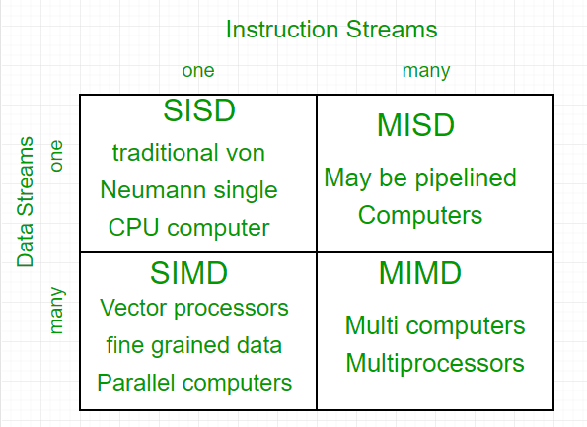
The crux of parallel processing are CPUs.
Based on the number of instruction and data streams that can be processed simultaneously, computing systems are classified into four major categories:
Flynn’s classification –

Slide 15
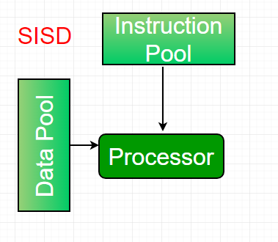
Single-instruction, single-data (SISD) systems – An SISD computing system is a uniprocessor machine which is capable of executing a single instruction, operating on a single data stream.
In SISD, machine instructions are processed in a sequential manner and computers adopting this model are popularly called sequential computers.
Most conventional computers have SISD architecture.
All the instructions and data to be processed have to be stored in primary memory.
The speed of the processing element in the SISD model is limited(dependent) by the rate at which the computer can transfer information internally.
Dominant representative SISD systems are IBM PC, workstations.

Slide 16
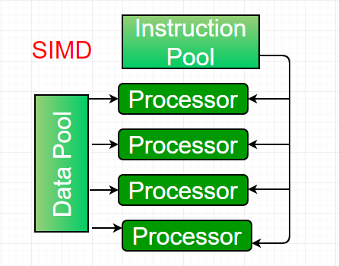
Single-instruction, multiple-data (SIMD) systems – An SIMD system is a multiprocessor machine capable of executing the same instruction on all the CPUs but operating on different data streams.
Machines based on an SIMD model are well suited to scientific computing since they involve lots of vector and matrix operations.
So that the information can be passed to all the processing elements (PEs) organized data elements of vectors can be divided into multiple sets(N-sets for N PE systems) and each PE can process one data set.
Dominant representative SIMD systems is Cray’s vector processing machine.

Slide 17
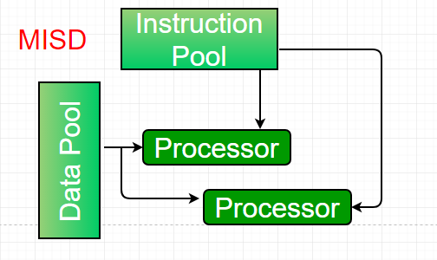
Multiple-instruction, single-data (MISD) systems – An MISD computing system is a multiprocessor machine capable of executing different instructions on different PEs but all of them operating on the same dataset .
Example Z = sin(x)+cos(x)+tan(x) The system performs different operations on the same data set.
Machines built using the MISD model are not useful in most of the application, a few machines are built, but none of them are available commercially.

Slide 18
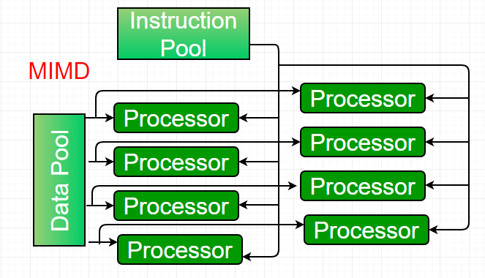
Multiple-instruction, multiple-data (MIMD) systems – An MIMD system is a multiprocessor machine which is capable of executing multiple instructions on multiple data sets.
Each PE in the MIMD model has separate instruction and data streams; therefore machines built using this model are capable to any kind of application.
Unlike SIMD and MISD machines, PEs in MIMD machines work asynchronously.
MIMD machines are broadly categorized into shared-memory MIMD and distributed-memory MIMD based on the way PEs are coupled to the main memory.

Slide 19
Multi-Core Processor
A multi-core processor is an integrated circuit that combines two or more processors to execute numerous tasks at once, minimize power consumption, and boost performance.
It has multiple instructions, which means that various cores run different threads that access different regions of memory.
It typically has two or more processors that read and execute computer instructions.
It’s also known as MIMD because all of the processors are on the same chip. (Multiple Instructions Multiple Data).

Slide 20
Simply described, a multi-core processor is a single chip with multiple processing units, or “cores,” each of which may execute distinct tasks.
For example, while conducting many tasks at once, such as watching a movie and using WhatsApp, one core will perform activities like viewing a movie while the second core performs another WhatsApp job.
Parallel computing is the foundation upon which the multi-core processor concept is built.
Because it contains two or more central processing units (CPUs) in a single chip, this can dramatically improve computer speed and efficiency.

Slide 21
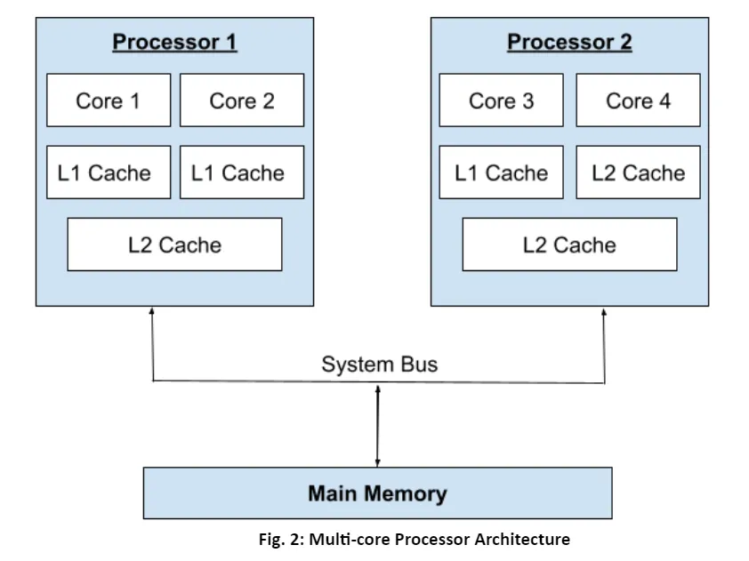
Multi-core Architecture:
The multi-core processor design facilitates the interaction between all available cores, and all processing jobs are split and assigned as needed.
After all processing processes are done, the processed data from each core is delivered back to the computer’s mainboard (motherboard) via a single common gateway.
In terms of total performance, this strategy outperforms a single-core CPU.

Slide 22
A multi-core processor’s architecture is shown in Figure 2. Two cores are present in the processors.
The two processors share the same system bus and main memory. Each core has its own L1 cache, also known as Level 1 cache.
The L2 cache, also known as the Level 2 cache, acts as a central repository for the various L1 caches.
If the CPU can’t find the data it needs to complete the next task in the L1 cache, it can look in the L2 cache.
The L2 cache is slower than the L1 cache, although it has more memory. Because the L2 cache is shared throughout the cores, it may be used to its maximum potential.

Slide 23
A multicore processor’s architecture allows communication between all available cores, ensuring that processing workloads are correctly divided and allotted among the cores.
The processed data from each core is transmitted back to the motherboard via a single shared gateway during the task completion phase.
When compared to a single-core CPU of comparable speed, this strategy considerably improves performance.

Slide 24
The following are some of the benefits of having a shared cache between cores:
If one of the cores isn’t using the cache, the other can, ensuring that the resources are used efficiently.
Provides programmers with more freedom by allowing for wider data sharing possibilities between cores with threads running in parallel.
The data for the other core can be preprocessed or post processed by one of the cores.
Allows for effective data sharing between cores and allows data requests to be addressed at shared-cache levels rather than in system memory.

